Slide 1
Persistency (Json file )
&&
Repository Design Pattern

Slide 2
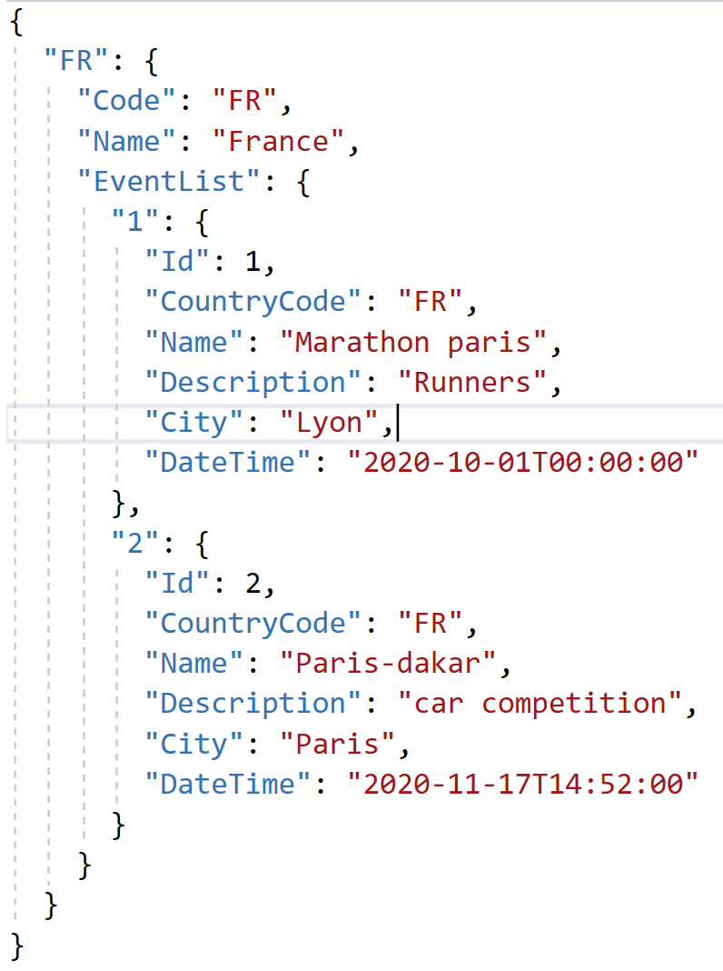
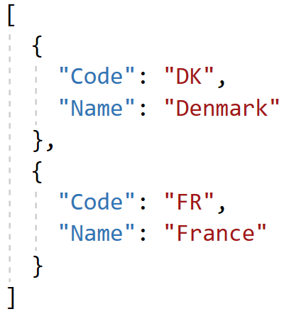
Json file structures
”CountryEvents.json” a json file with a Country Dictionary object holding 2 Event Dictionary objects
”Country.json”, a Simple json file with 2 Country objects

Slide 3
Why JSON?
JSON provides a general and convenient way of transform­ing C# objects to a text format, which can then easily be written to a file.
Serialization
WritteToFile
List<…>
(domain objects)
string
(JSON format)
File
(text)
Deserialisation
ReadFromFile

Slide 4
What is Repository Pattern
Repository Pattern is an abstraction of the Data Access Layer.
It hides the details of how data is saved or retrieved from the underlying data source.
The details of how data is stored and retrieved is in the respective repository

Slide 5
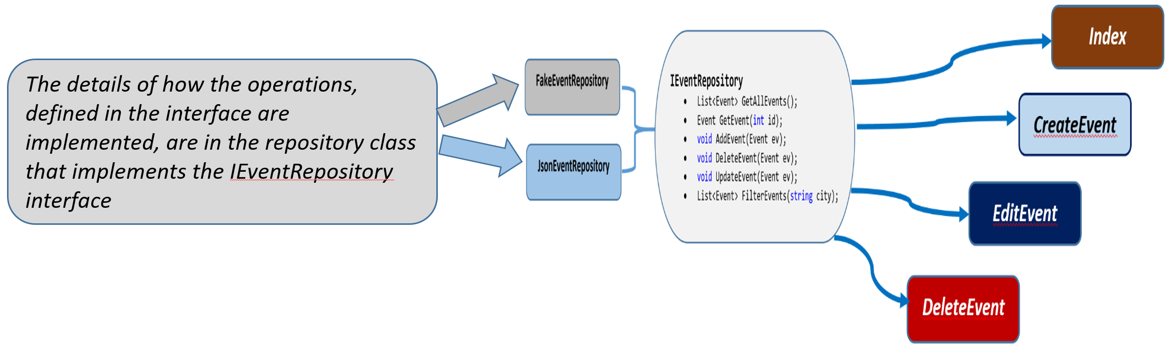
What is Repository Pattern

Slide 6
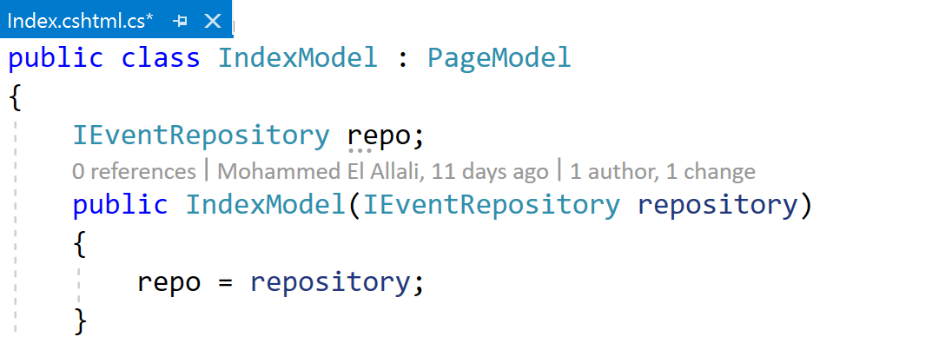
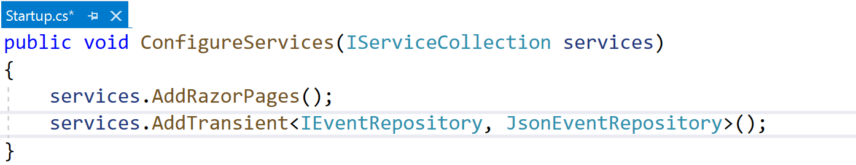
Which implementation to use?
Dependency injection
Service configuration

Slide 7
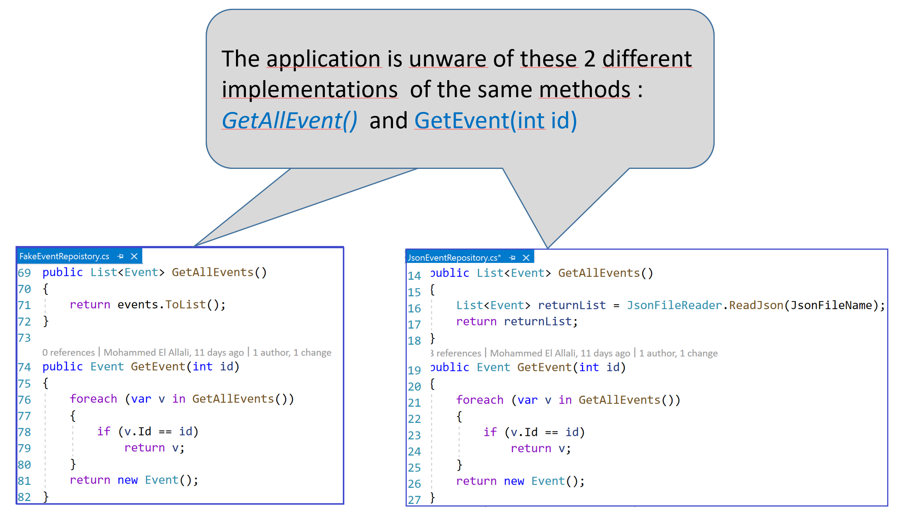

Slide 8
Benefits of Repository Pattern
The code is cleaner, and easier to reuse and maintain.
Enables us to create loosely coupled systems.
For example, if you want your application to work with Sql Server instead of Json file, implement the SQL database access layer and register it with the dependency injection system.
In an unit testing project, it is easy to replace a real repository with a fake implementation for testing.

